Slide 1


Convolution Layer
Output (3x3x2)
Input (5x5x1) Padding: 1
Filter $ω_{0}$ (3x3x2)
Filter $ω_{1}$ (3x3x2)
The number of filters determines the number of outputs. Each filter calculates one output matrixSetting the stride and kernel size both to 2 will result in the output being exactly half the size of the input along both dimensions. -> Pooling Layer [https://leonardoaraujosantos.gitbooks.io/artificial-inteligence/content/convolution.html] Nice Explanation [https://deeplearning4j.org/convolutionalnetwork.html]
x[:,:,0]
w0[:,:,0]
w1[:,:,0]
2 | 4 | 7
 | 0 | 7
6 | 1 | 4
0 | 0 | 0 | 0 | 0 | 0 | 0
0 | 0 | 1 | 1 | 0 | 2 | 0
0 | 2 | 1 | 0 | 2 | 1 | 0
0 | 0 | 2 | 0 | 0 | 1 | 0
0 | 2 | 0 | 1 | 2 | 2 | 0
0 | 1 | 2 | 0 | 2 | 0 | 0
0 | 0 | 0 | 0 | 0 | 0 | 0
0 | 0 | -1
1 | 1 | 0
0 | 1 | 0
-1 | 1 | 0
-1 | -1 | 1
-1 | 0 | 0
filtered with w0
w0[:,:,1]
w1[:,:,1]
 | 4 | 7
 | 0 | 7
6 | 1 | 4
0 | 1 | -1
0 | 1 | 1
1 | 0 | 0
0 | 0 | 1
1 | 0 | 1
0 | -1 | 0
filtered with w1

Slide 2
Max Pooling Operation / Down-Sampling
1 | 5 | 2 | 4
4 | 1 | 6 | 9
2 | 2 | 2 | 1
4 | 1 | 0 | 1
x
max pool operation
5 | 9
4 | 2
filter dimension | 2x2
stride | 2
y

Slide 3
Max Unpooling Operation / Up-Sampling
0.1 | 5.2 | 2.2 | 4.1
4.0 | 0.1 | -6.0 | 9.0
-2.0 | 2 | 2.1 | 1.2
4.3 | 1.7 | 0 | -1.7
max pool operation
5.2 | 9.0
4.3 | 2.1
 | X
 |  |  | X
 |  | X
X
0 | 3.4 | 0 | 0
0 | 0 | 0 | 6.8
0 | 0 | 0.9 | 0
5.6 | 0 | 0 | 0
max unpool operation
3.4 | 6.8
5.6 | 0.9

Slide 4
Max Unpooling Operation / Up-Sampling
5.2 | 5.2 | 9.0 | 9.0
5.2 | 5.2 | 9.0 | 9.0
4.3 | 4.3 | 2.1 | 2.1
4.3 | 4.3 | 2.1 | 2.1
5.2 | 9.0
4.3 | 2.1
Nearest Neighbor
5.2 | 0 | 9.0 | 0
0 | 0 | 0 | 0
4.3 | 0 | 2.1 | 0
0 | 0 | 0 | 0
5.2 | 9.0
4.3 | 2.1
“Bed of Nails”

Slide 5
Input x
activation
Wx
1
1
3072
10
weights 10 x 3072

Slide 6
32x32x3 image
5x5x3 filter ω
32
28
convolve filter
over all locations
32
Dot product of filter
and 5x5x3 chunk of the image
28
3
1

Slide 8


Input (5x5x1) Padding: 1, Stride: 2
Output (3x3x2)
Filter $ω_{0}$ (3x3x1)
Filter $ω_{1}$ (3x3x1)
x[:,:,0]
w0[:,:,0]
w1[:,:,0]
o[:,:,0]
0 | 0 | 0 | 0 | 0 | 0 | 0
0 | 0 | 1 | 1 | 0 | 2 | 0
0 | 2 | 1 | 0 | 2 | 1 | 0
0 | 0 | 2 | 0 | 0 | 1 | 0
0 | 2 | 0 | 1 | 2 | 2 | 0
0 | 1 | 2 | 0 | 2 | 0 | 0
0 | 0 | 0 | 0 | 0 | 0 | 0
0 | 0 | -1
1 | 1 | 0
0 | 1 | 0
-1 | 1 | 0
-1 | -1 | 1
-1 | 0 | 0
2 | 2 | 3
1 | 1 | 3
1 | 0 | 2
filtered with w0
o[:,:,1]
1 | -3 | -4
4 | -3 | -4
3 | 1 | -2
filtered with w1

Slide 9
input
1 | 5 | 2 | 4
4 | 1 | 6 | 9
2 | 2 | 2 | 1
4 | 1 | 0 | 1
output
x
max pool operation
5 | 9
4 | 2
filter dimension | 2x2
stride | 2
y

Slide 10
32
32
96
32
32
6
224²
64
64
64
224²
192
128
128
384
128
112²
112²
56²
256
256
768
256
56²
UpConvolution
512
MaxPool
28²
28²
Conv + BN + ELU
14²
Conv + Softmax

Slide 11
32
32
96
32
6
32
244²
64
64
192
64
244²
128
128
384
128
112²
112²
56²
256
256
768
256
56²
UpConvolution
512
MaxPool
28²
28²
Conv + BN + ELU
14²
Conv + Softmax

Slide 12
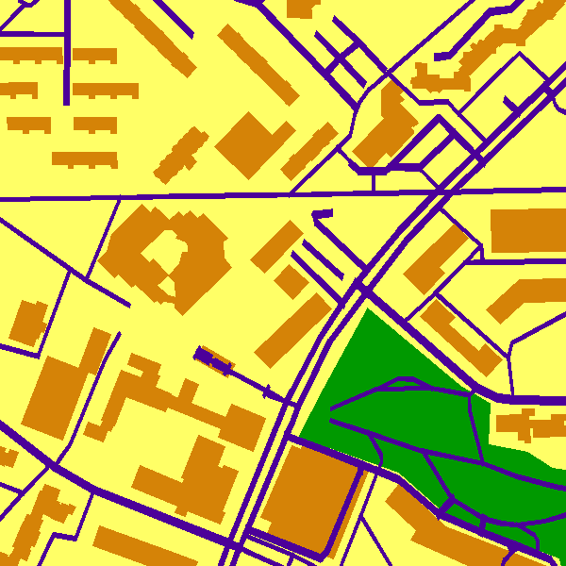
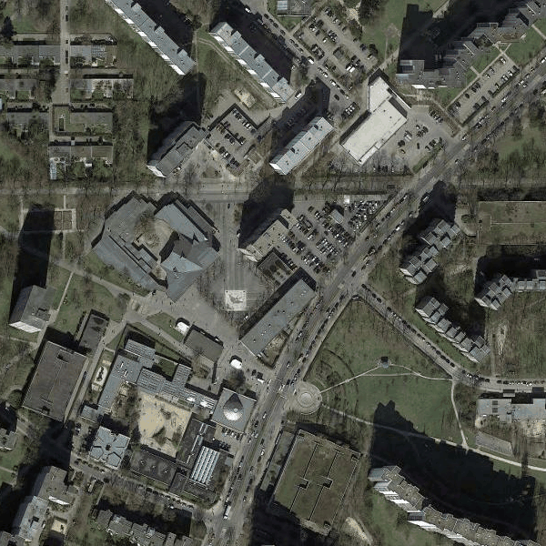









Convs
Dilated Convs
Reduced Conv
$$\frac{1}{8}$$
$$\frac{1}{16}$$
$$\frac{1}{32}$$
$$\frac{1}{32}$$
$$\frac{1}{32}$$
$$...$$
$$\frac{1}{16}$$
$$\frac{1}{4}$$
$$1$$
$$\frac{1}{4}$$
$$\frac{1}{8}$$
$$\frac{1}{16}$$
$$\frac{1}{16}$$
CFF
$$\frac{1}{8}$$
$$\frac{1}{4}$$
$$\frac{1}{2}$$
$$\frac{1}{2}$$
$$\frac{1}{4}$$
$$\frac{1}{8}$$
$$\frac{1}{8}$$
$$\frac{1}{4}$$
$$\frac{1}{4}$$
$$1$$
CFF
Test only
Train only
$$1$$

Slide 13
Convs
Dilated Convs
Reduced Conv
$$\frac{1}{8}$$
$$\frac{1}{16}$$
$$\frac{1}{32}$$
$$\frac{1}{32}$$
$$\frac{1}{32}$$
$$...$$
$$\frac{1}{16}$$
$$\frac{1}{4}$$
$$1$$
$$\frac{1}{4}$$
$$\frac{1}{8}$$
$$\frac{1}{16}$$
$$\frac{1}{16}$$
CFF
$$\frac{1}{8}$$
$$\frac{1}{4}$$
$$\frac{1}{2}$$
$$\frac{1}{2}$$
$$\frac{1}{4}$$
$$\frac{1}{8}$$
$$\frac{1}{8}$$
$$\frac{1}{4}$$
$$\frac{1}{4}$$
$$1$$
CFF
Test only
Train only
$$1$$

